Slide 1
P2P Logistics

Slide 2

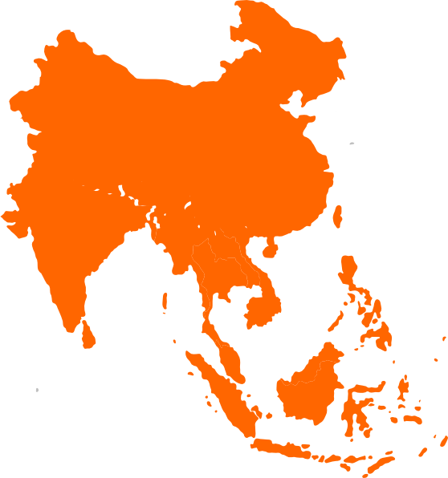
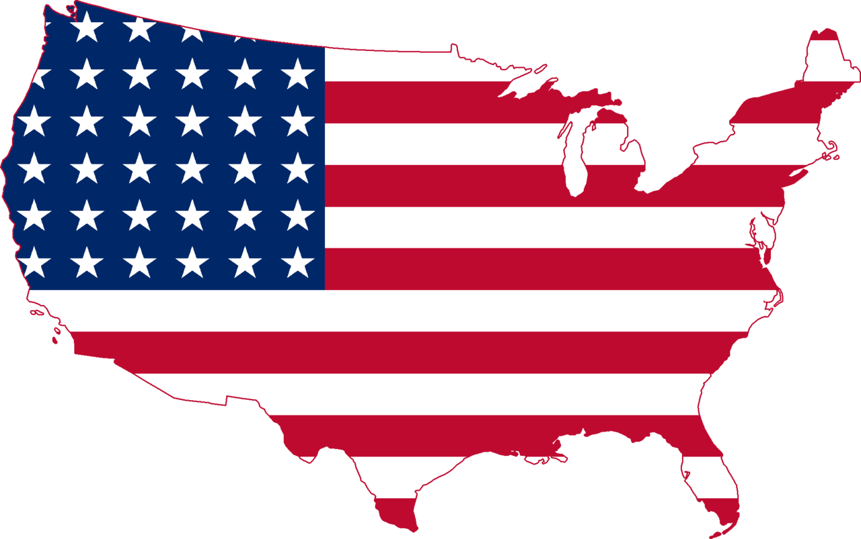





Conventional

Slide 3



Market Problem
Huy (Boston) wants to send an iPhone back to Vietnam, it costs $120 through logistic service/agent. Huy does not want to pay that much of money for a slow delivery (2 weeks).
Cheryl (NY) will flight to Vietnam to visit her friends the next day. She has a lot of empty space in her luggage.
Notes:
ship oversea

Slide 4

Market Problem
Khue (HCMC, VN) wants to buy a LV bag for his gf as her bday is coming up. In VN, it costs almost twice as the price on the Singapore LV website. Khue can’t afford the same bag in VN and he is seeking someone in the Sing to help him order it and also need to be shipped before the birthday.
Huy (Tourist) is from VN, he will travel to Singapore for 2 days, and he will leave tomorrow morning to start the trip. He tell his friend that he has a lot of free space in his luggage, if anyone want to buy things from Singapore? However, nobody wanna buy anything.
Notes:
buy things oversea

Slide 5
Solution
Cross-Global Peer to Peer Delivery & Shop U.S based

Slide 6
Traditional Logistics Disadvantages
Slow
Air - at least 10 days
Sea - 1 to 3 months
Restrictive
Drugs
Lithium Batteries
Food
Liquid
are prohibited.
Expensive
1kg = 32 Dollars approximate
Next day arrival, during weekends cost > $50 in the US.

Slide 7
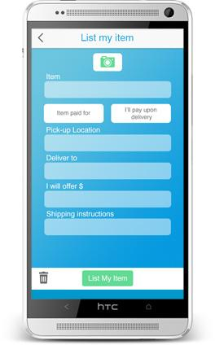
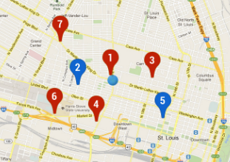
How it works:
1
2
YOU
Enter the item into the system and select destination.
e.g. Vietnam
Other Pins on the map represent people nearby who has an upcoming flight to Vietnam.

Slide 8
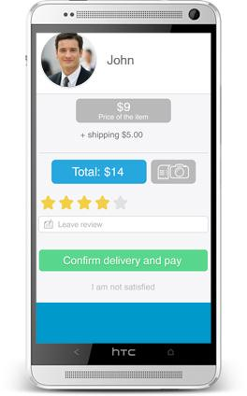

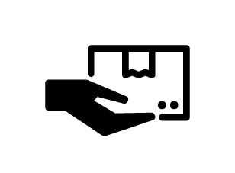
3
4
5
Meet up to hand over the item
or
mail it to sender.
Sender travels with item to the Destination.
Select cheapest and closest sender offer.

Slide 9
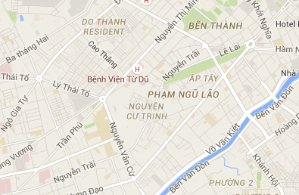
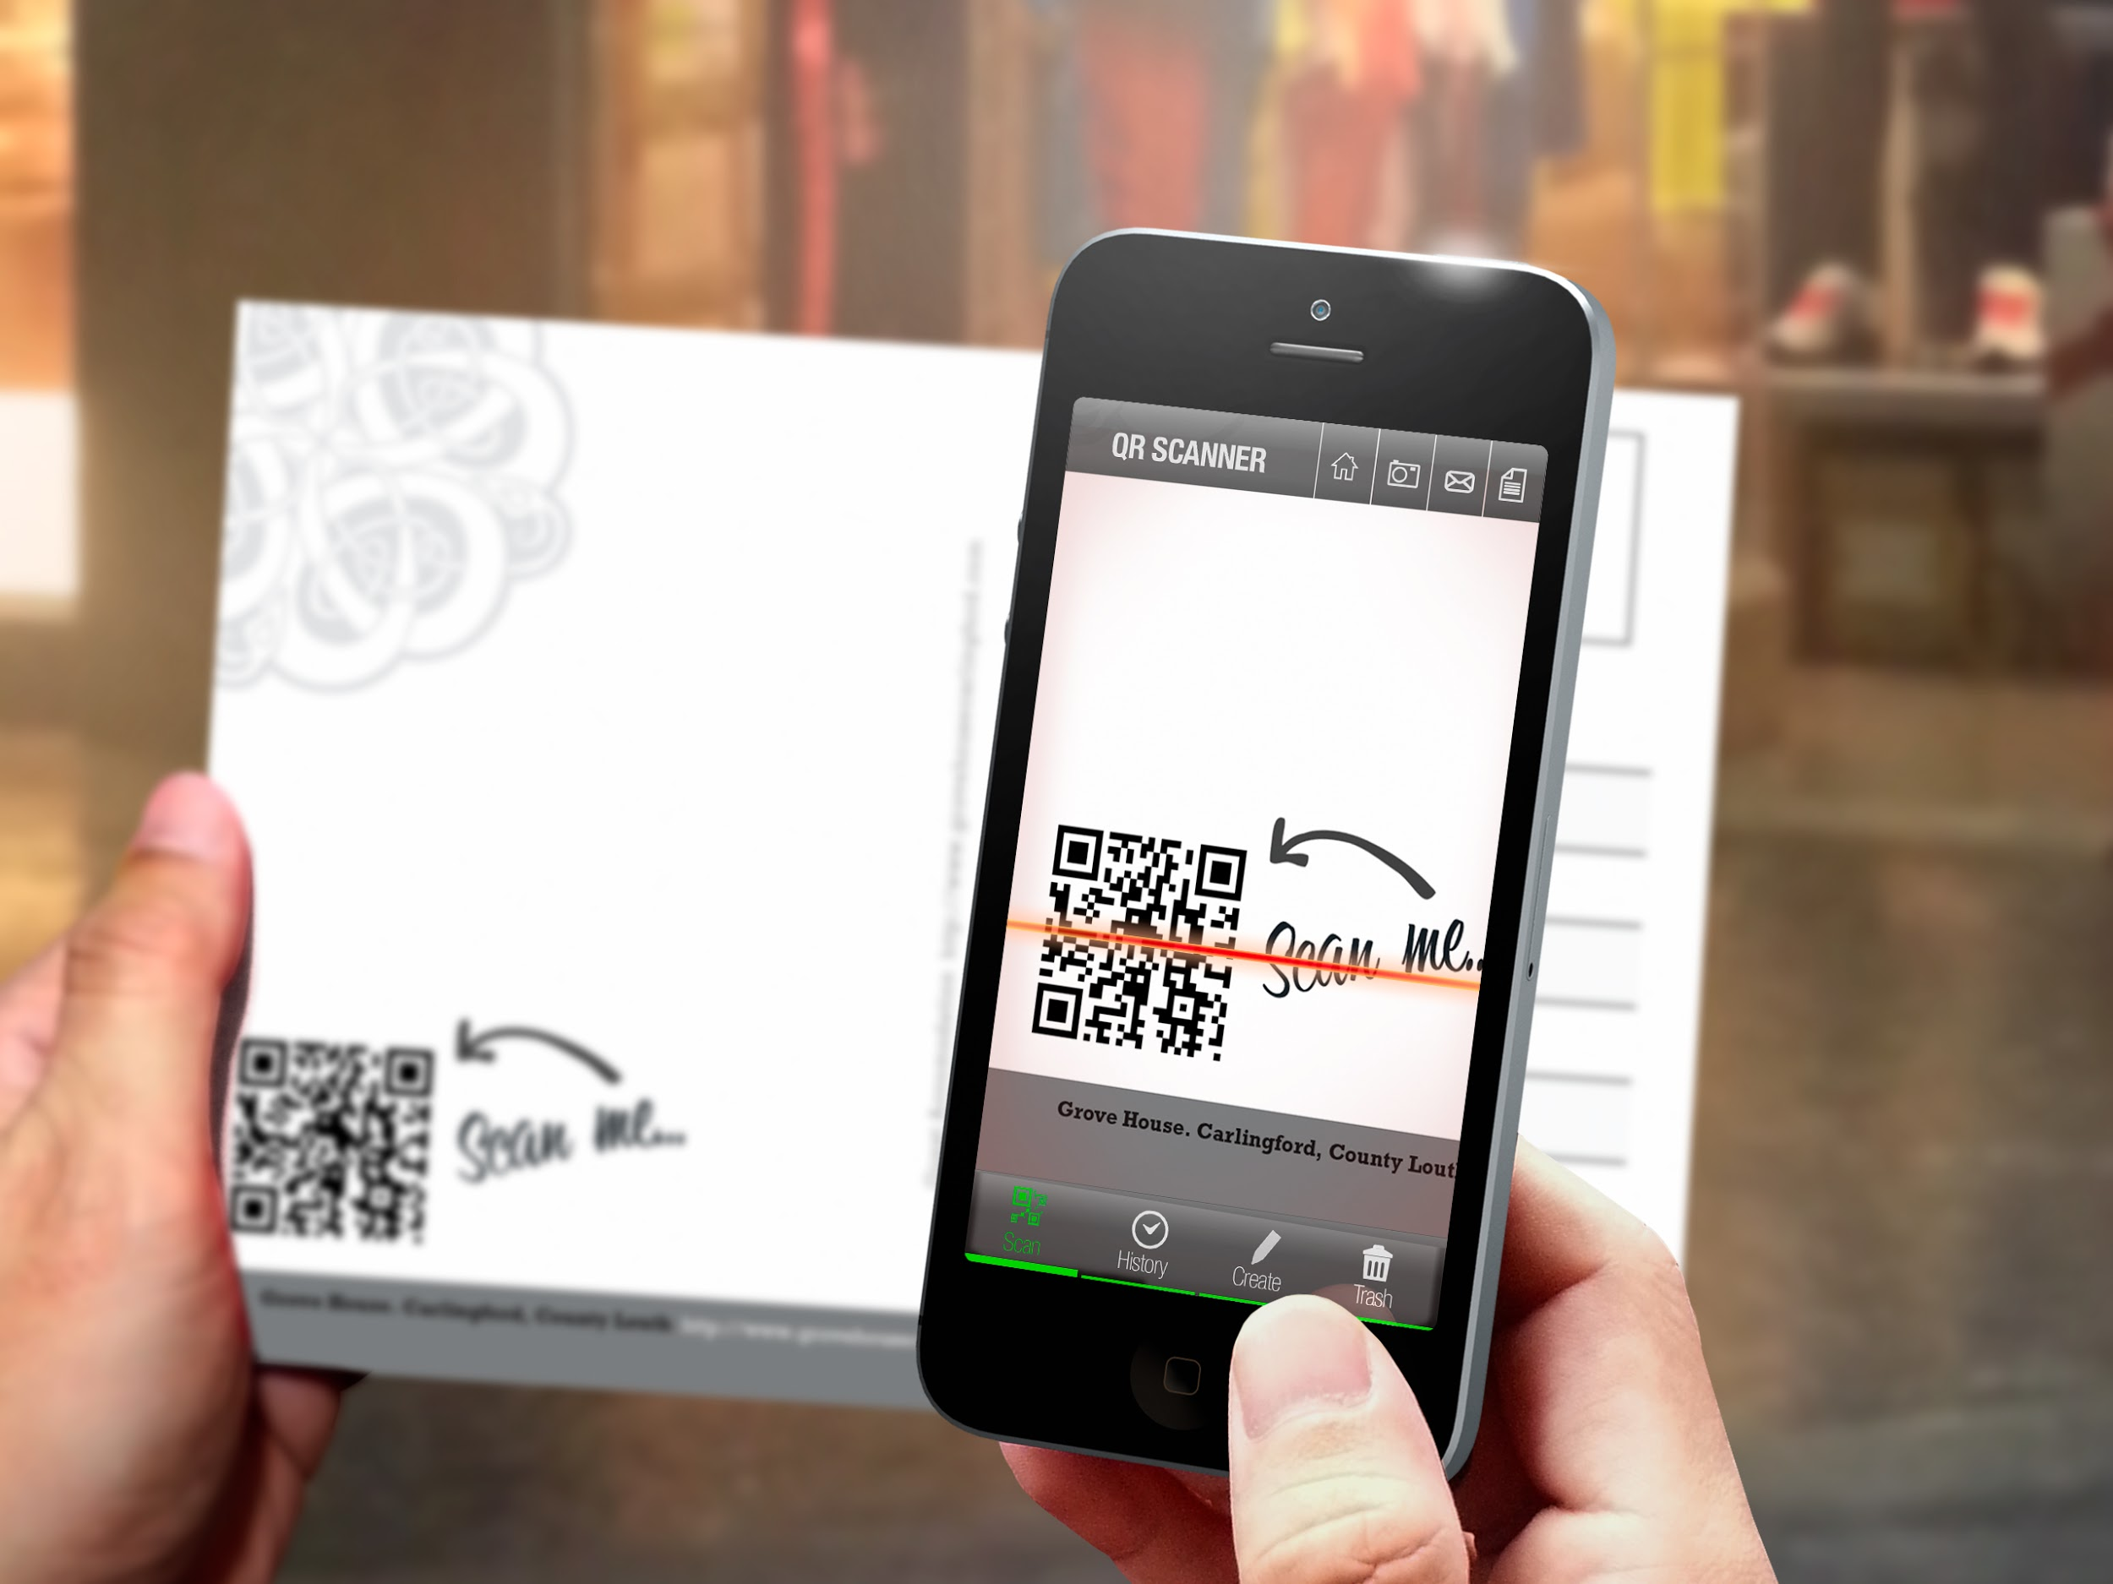


6
7
Sender looks for the receiver on the map to deliver the item.
or
Sender mails the item to the receiver through domestic shipping services.
Verify delivery
*e.g. Randomised QR code

Slide 10

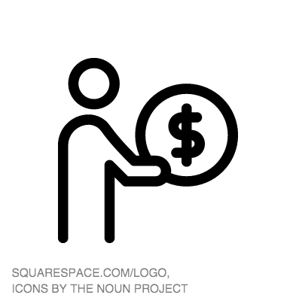
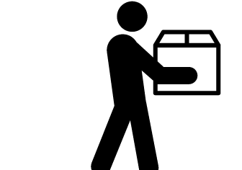
8
Sender gets paid and item is delivered.

Slide 11
Benefits
$
Save money sending things over the world.
Earn pocket money.
Connectivity
Meet new people.
Establish business connections.
Travel
Makes travel more worthwhile
Go where the locals go
New Experiences
Makes shopping a worldwide experience anytime.
Reduces geological limitations.

